Slide 1

Predicting the energy output of wind turbine based on weather condition

Slide 2
IBM HACK challenge- 2020
Name: Shevya Solanki
BRANCH: Computer Science & Engineering
PROJECT ID: SPS_PRO_700
Category: Machine Learning

Slide 3
Idea Behind the Project!!
Wind energy plays an increasing role in the supply of energy worldwide. The energy output of a wind farm is highly dependent on the wind conditions present at its site
. If the output can be predicted more accurately, energy suppliers can coordinate the collaborative production of different energy sources more efficiently to avoid costly overproduction develop a time series model to predict the power output of wind farm based on the weather condition in the site .
Developing a time series model to Predict the power output of wind farm based on the weather condition in the site (1Hr prediction to 72Hrs. prediction) Build an application to recommend the Power Grid to suggest the best time to utilize the energy from wind farm.

Slide 4
WORKFLOW!!
The project is completed by performing IBM Machine Learning & IBM Watson Studio using Auto-AI experiment which consists of 8 algorithms to be performed out of which the best one is selected for deployment.
Node-Red starter kit is used to build the UI(User Interface) so that user/customer can enter their details and get the predictions.
Charts are also used to show the Energy output predictions through various graphs such as Liner Graph Analysis & Bar graph to show the user the predicted values.

Slide 5
Requirements !!
Python, IBM Cloud Platform, IBM Watson, Github , Node Red in IBM Watson, Jupyter Notebook Watson.
Python 2 or 3, IBM Watson Studio, IBM Cloud for Deployment, Android / any Web frameworks Use Weather Company Data from IBM Cloud.

Slide 6
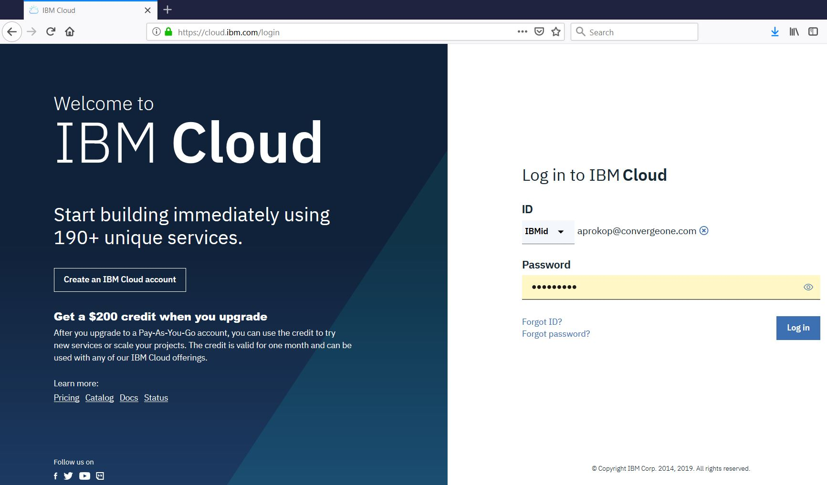

Slide 7
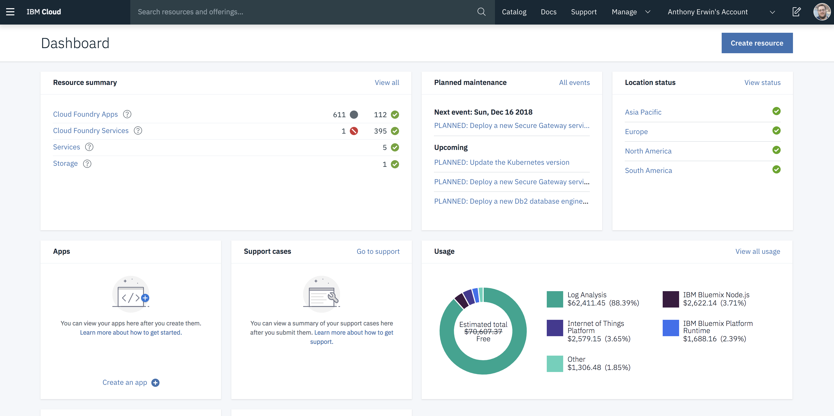

Slide 8
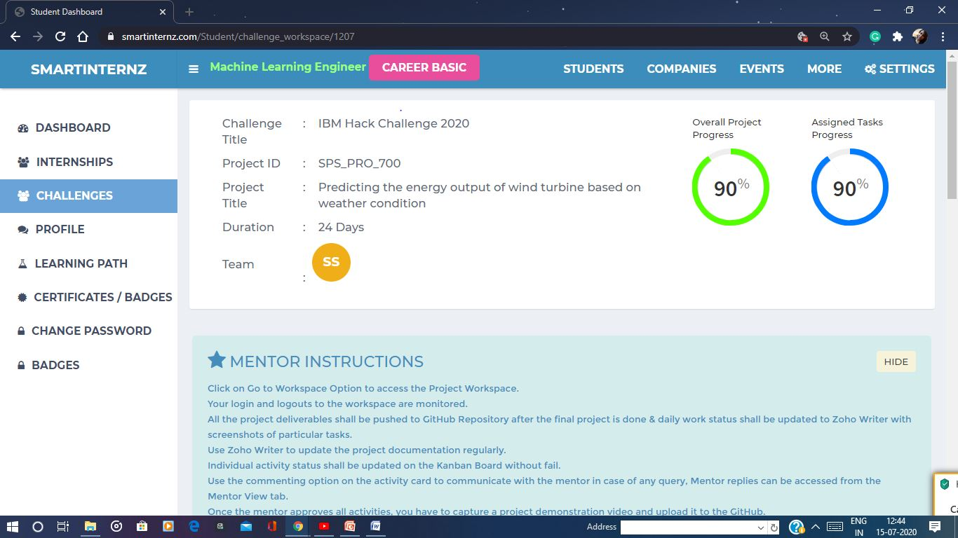
SMARTINTERNZ DAshBoard

Slide 9
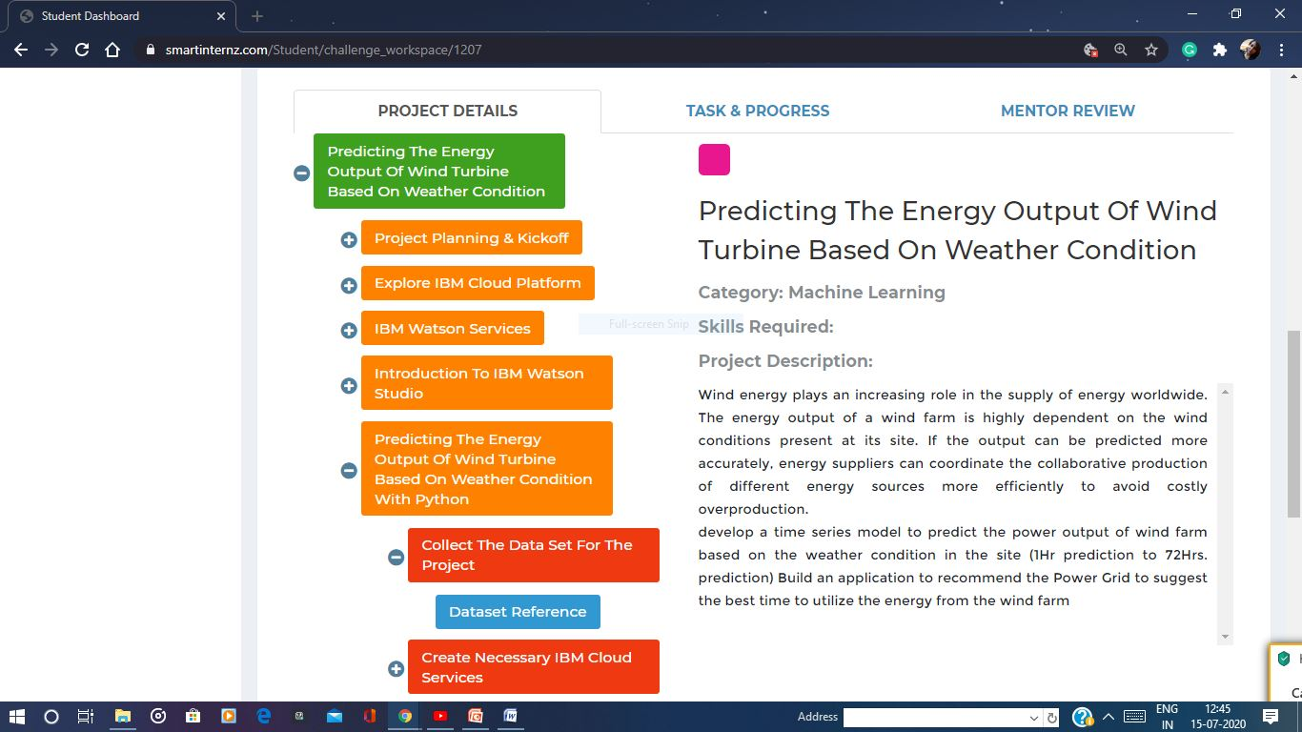

Slide 10
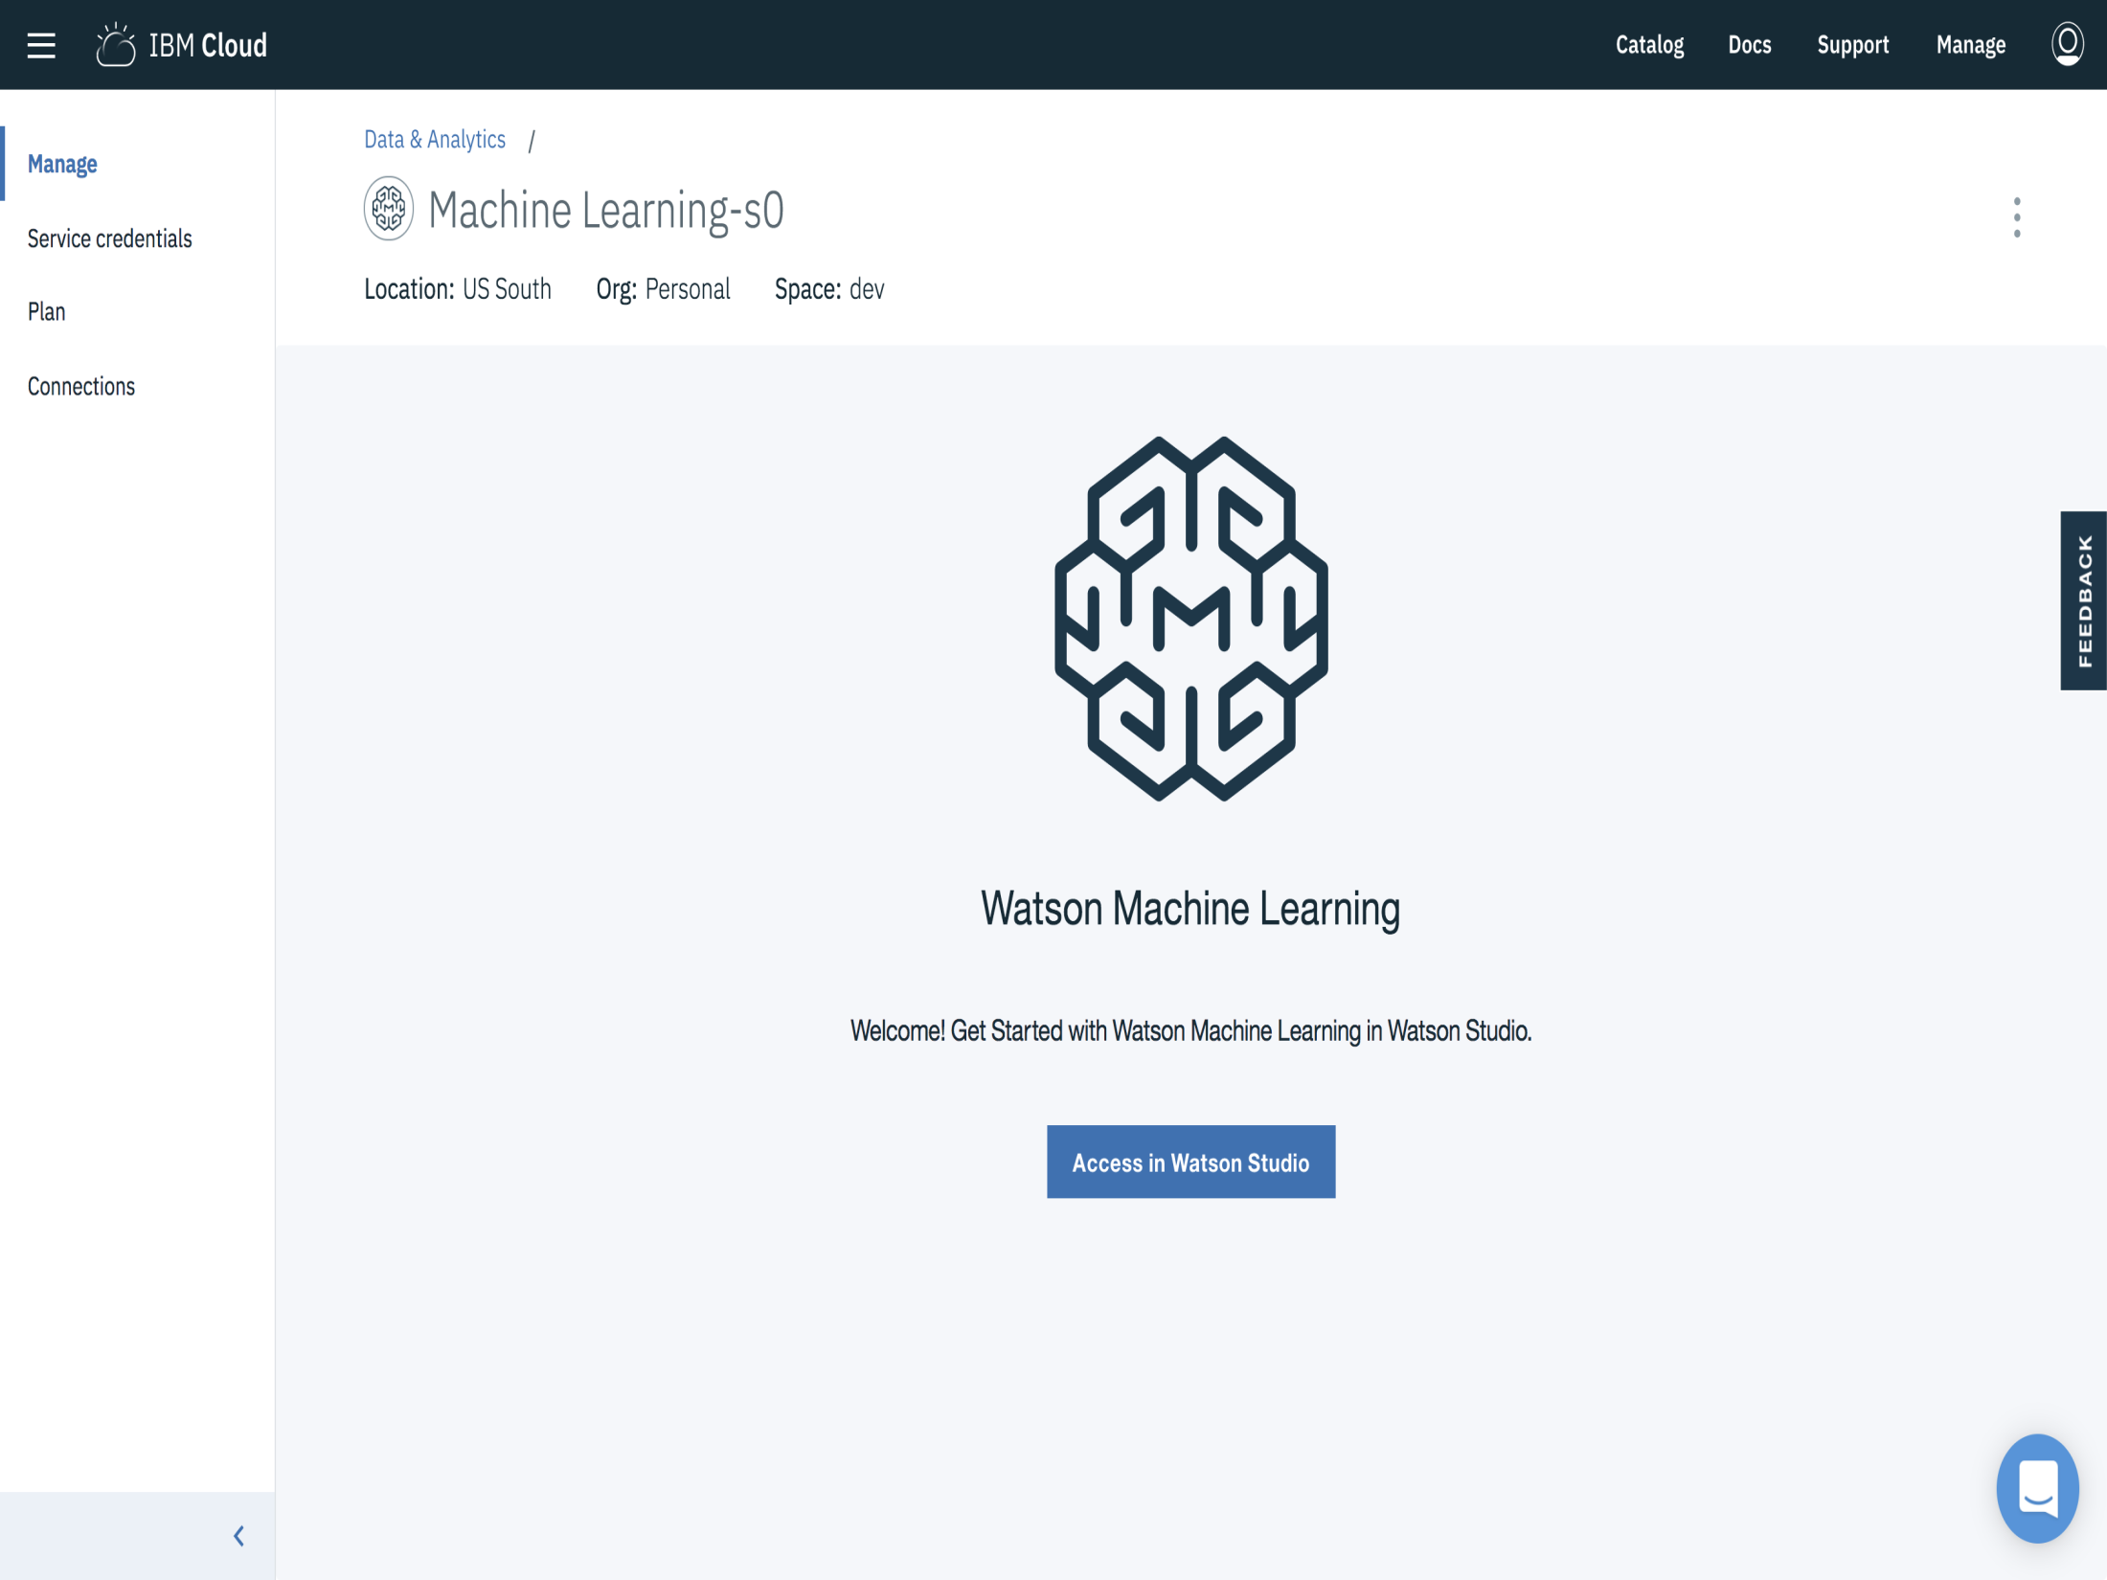

Slide 11
IBM WATSON MACHINE LEARNING
Watson Machine Learning provides
Deploy models built with IBM Watson Studio and open source tools.
Dynamically retrain models
Automatically generate APIs to build AI-powered applications
Manage models through integration with IBM Watson Openscale™
Streamline model management and deployment end-to-end with an easy-to-use interface

Slide 12
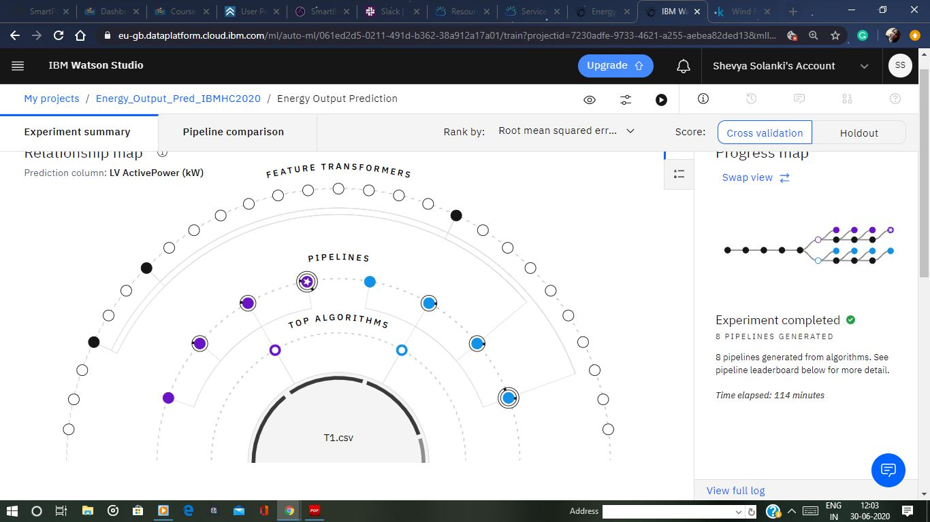

Slide 13
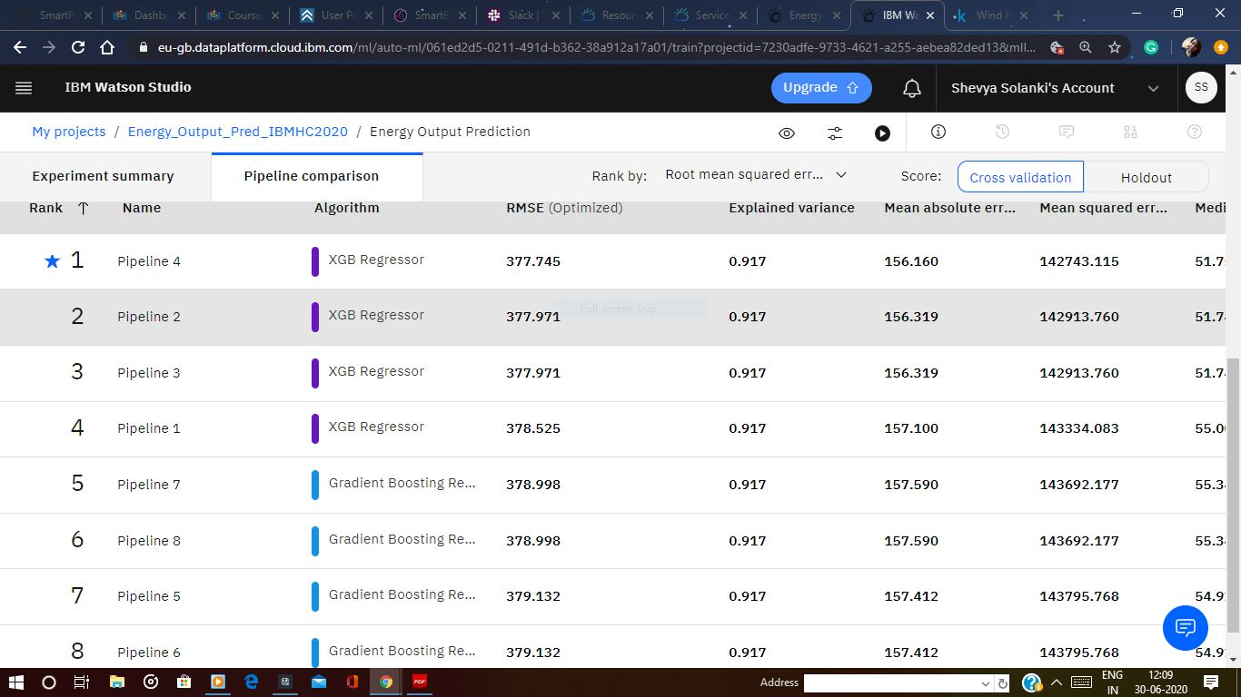

Slide 14
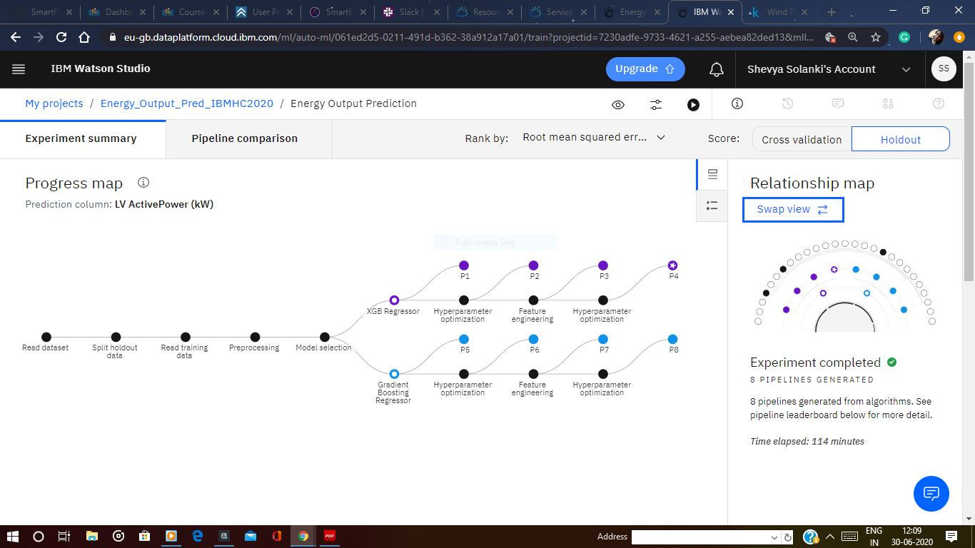

Slide 15
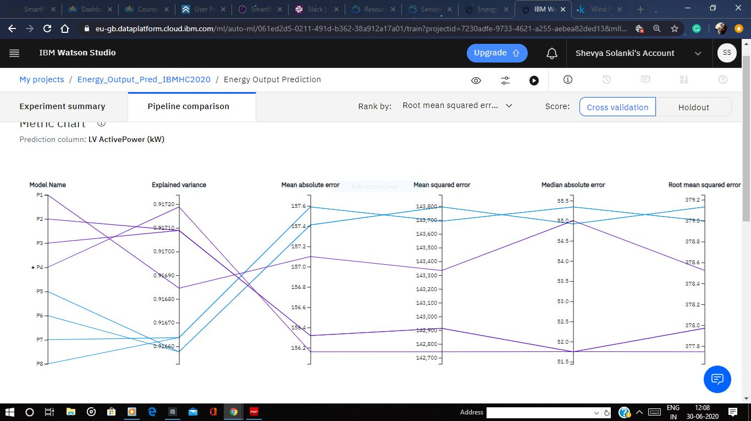

Slide 16
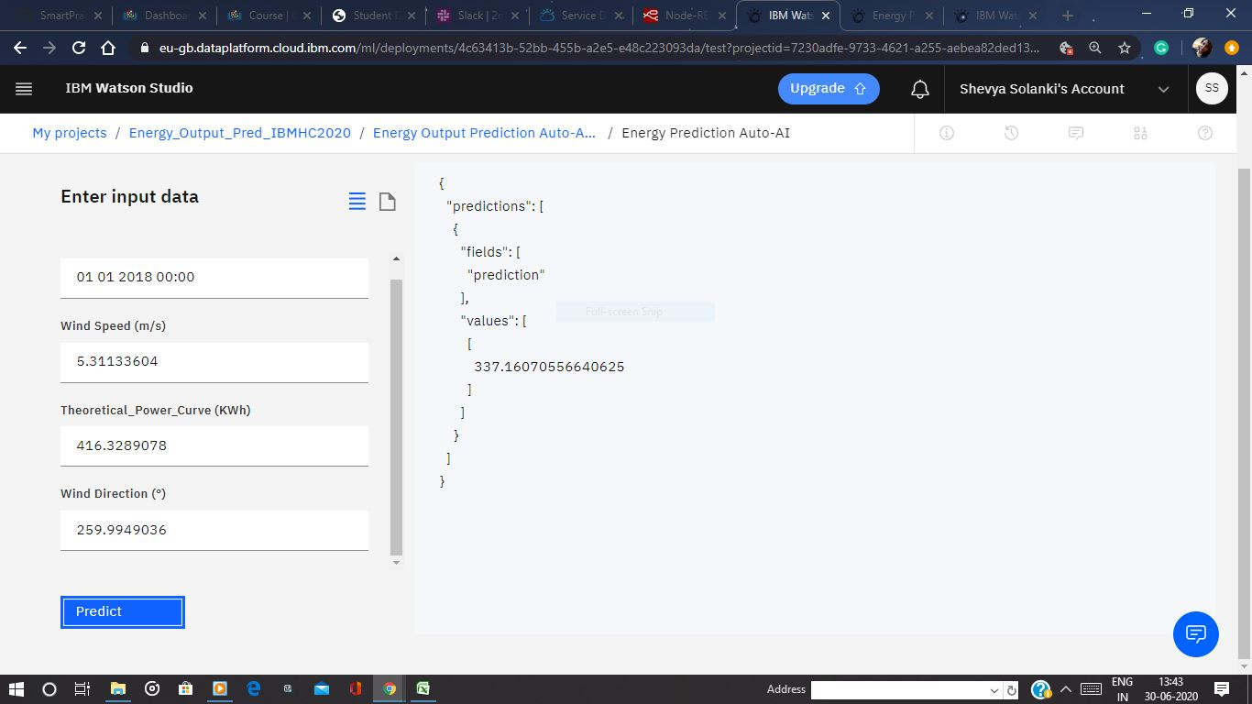

Slide 17
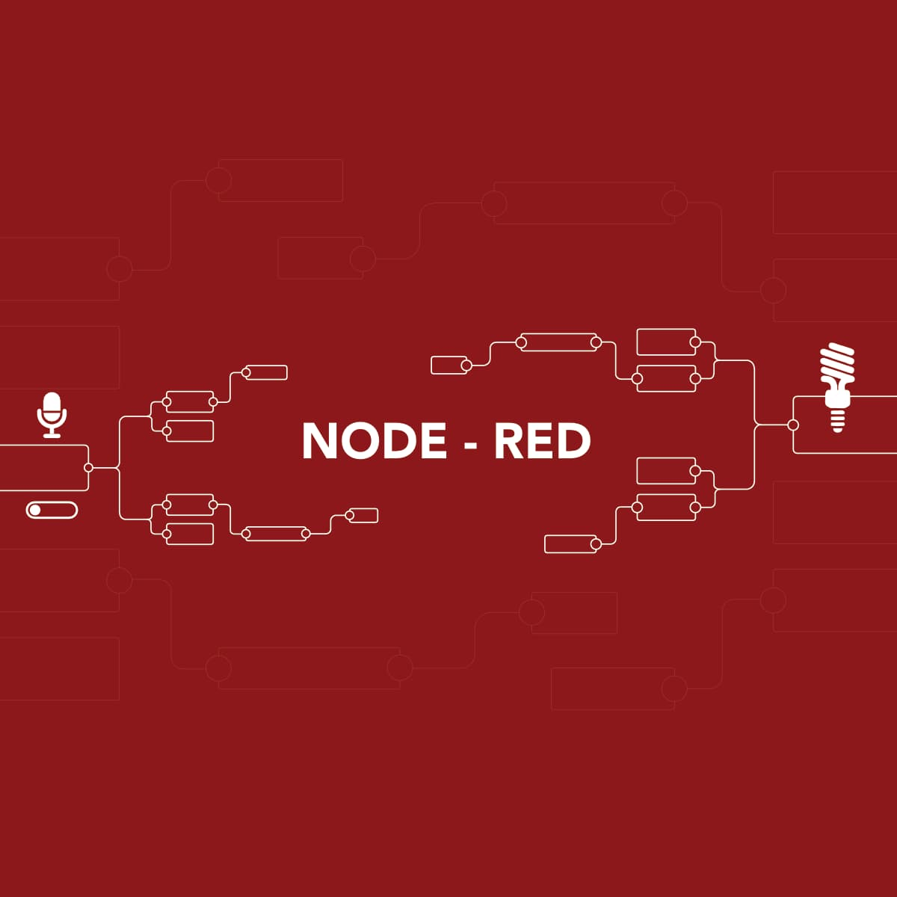
Node-RED is a programming tool for wiring together hardware devices, APIs and online services in new and interesting ways.
It provides a browser-based editor that makes it easy to wire together flows using the wide range of nodes in the palette that can be deployed to its runtime in a single-click.

Slide 18
IDEA ABOUT NODE-RED !
Node-RED is a programming tool for wiring together hardware devices, APIs and online services in new and interesting ways.
It provides a browser-based editor that makes it easy to wire together flows using the wide range of nodes in the palette that can be deployed to its runtime in a single-click.

Slide 19
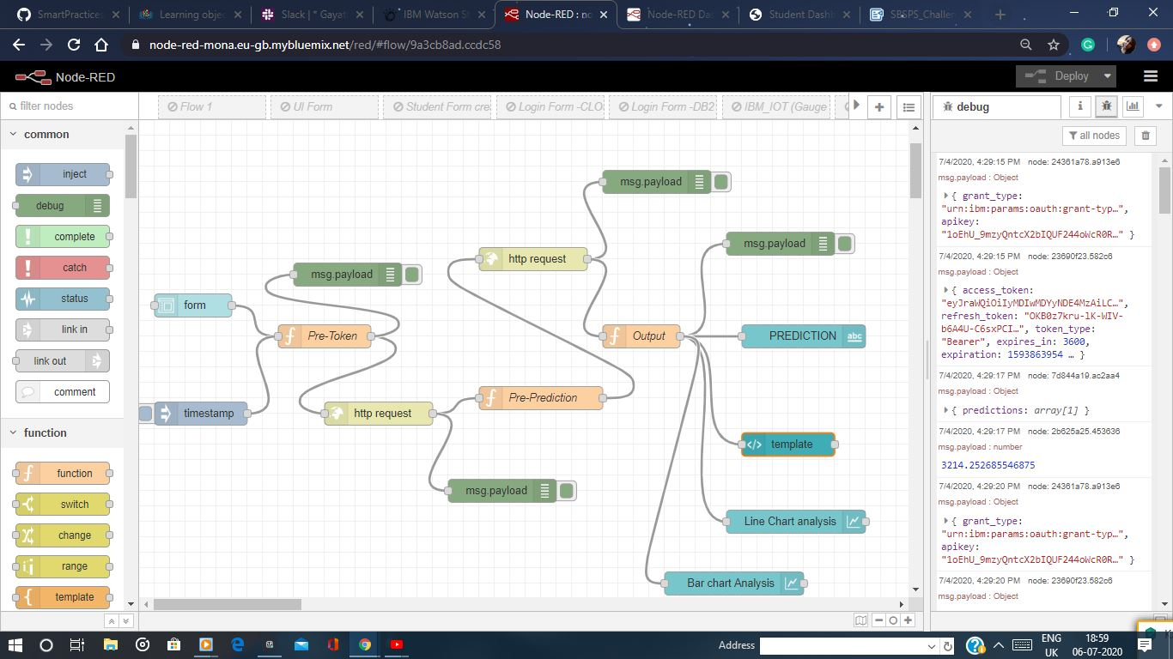

Slide 20
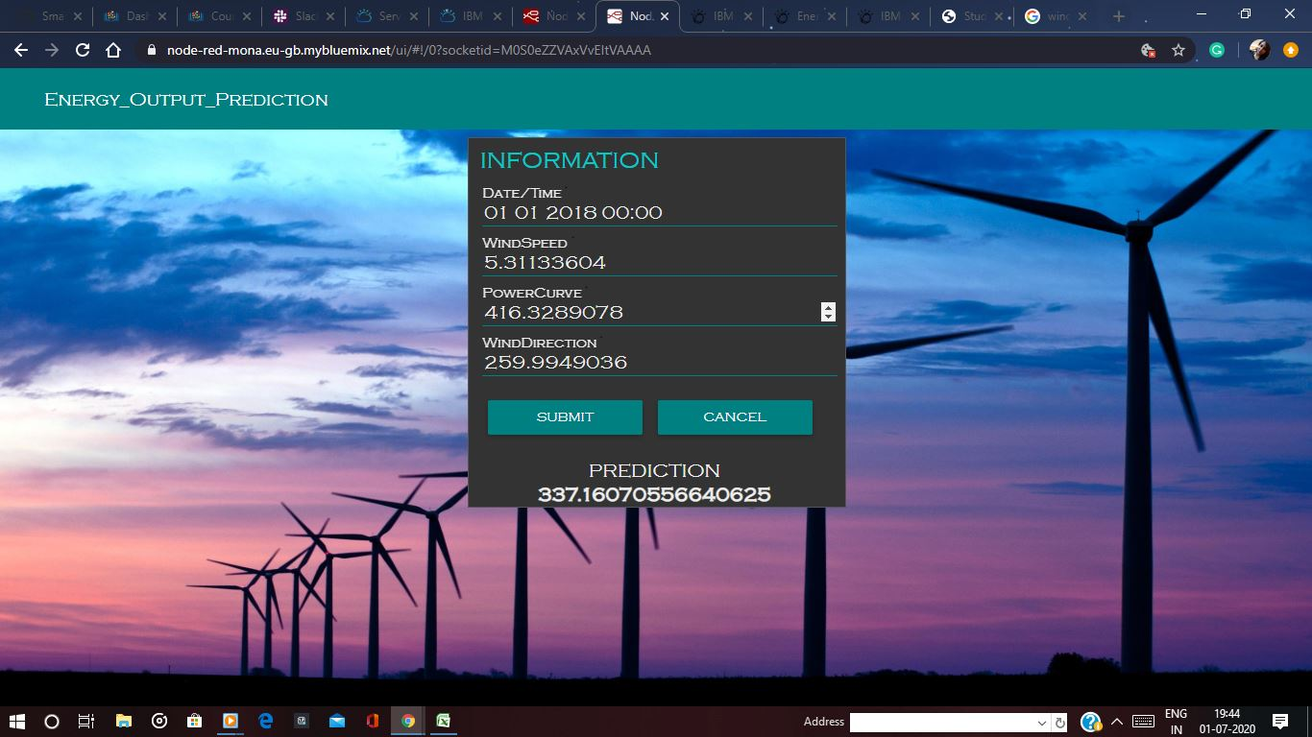

Slide 21
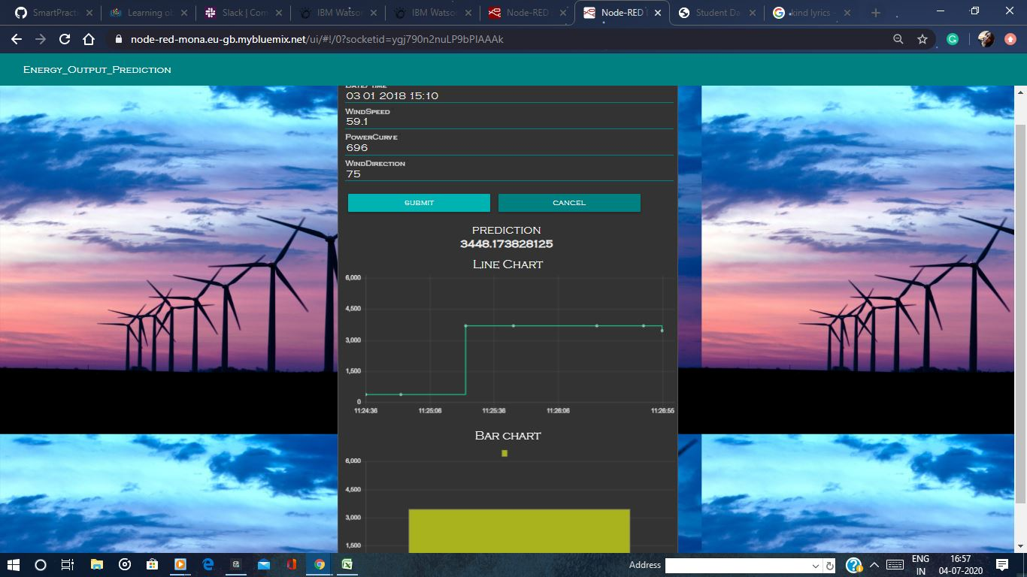

Slide 22
THANK YOU

